Slide 4
Design
Presentation typeface is Arial
Text basic colour: RGB 57/70/74
Highlighted text colours:
RGB 122/193/67 (CEITEC Green)
RGB 33/169/192

Slide 5
Graph Examples

Slide 6
Table Example
Header 1 | Header 2 | Header 3
Cell | Value | Value
Cell | Value | Value
Cell | Value | Value
Cell | Value | Value
Cell | Value | Value
Cell | Value | Value
Cell | Value | Value
Cell | Value | Value
Cell | Value | Value

Slide 7
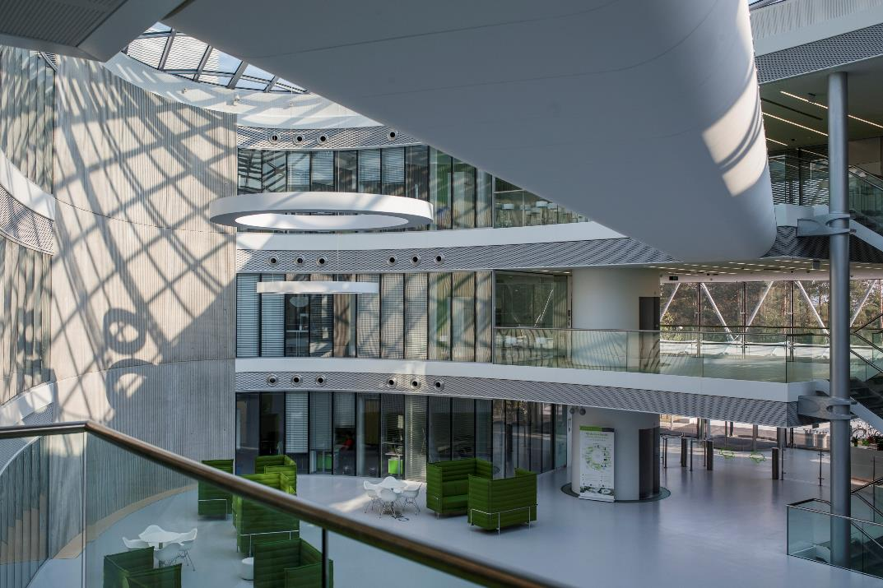
Slide with picture

Slide 8
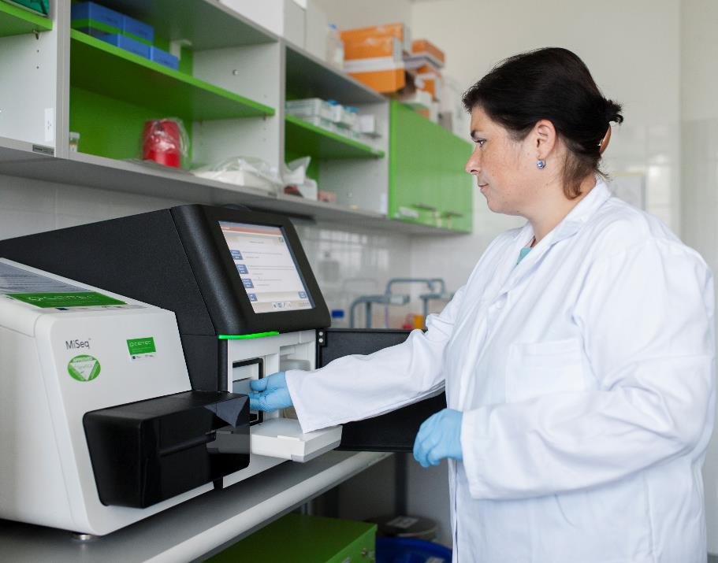
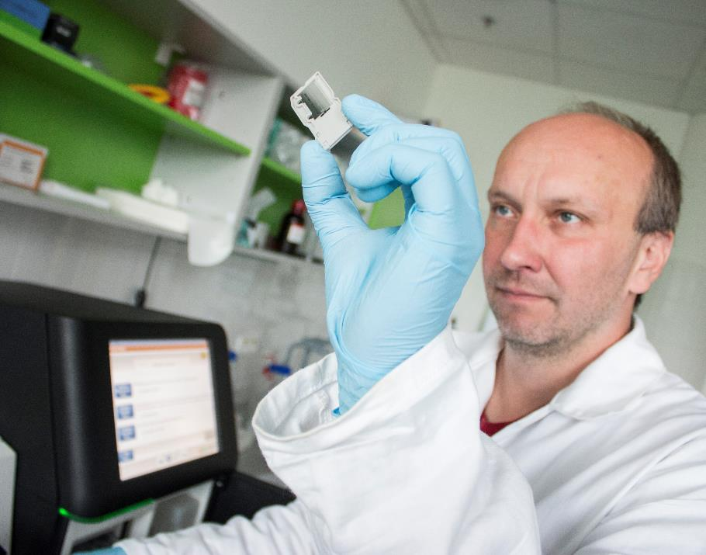
Slide with two pictures

Slide 9
Built on a foundation of 6 core institutions

Slide 10
CEITEC
@CEITEC_Brno
www.ceitec.eu

Slide 11
CEITEC
@CEITEC_Brno
www.ceitec.eu

Slide 12
CEITEC
@CEITEC_Brno
www.ceitec.eu

Slide 13
CEITEC
@CEITEC_Brno
www.ceitec.eu

